Slide 1
IoT based Home Security system

Slide 2
INTRODUCTION
In this project, we will learn about how to use the Adafruit IO platform to record, analyze, and control the live data on the cloud. You can upload, display, and monitor your data over the internet and make your project IoT enabled. You can even control motors, buzzers, and sensors using it.

Slide 3
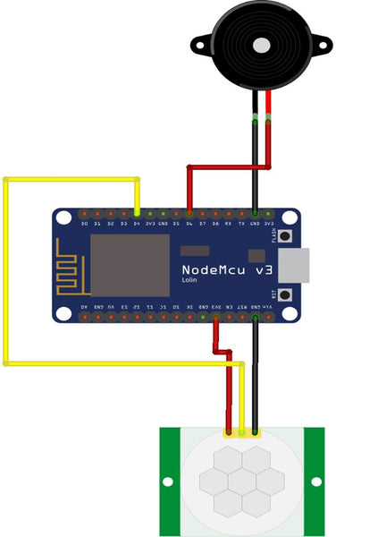
CIRCUIT DIAGRAM

Slide 4
Components Required
NodeMCU ESP8266
USB B type Data Cable
PIR (Passive Infrared) Sensor
Piezo buzzer
Jumper Wires
Breadboard

Slide 5
What is NODE MCU
NodeMCU is an open-source firmware and development kit that helps you to prototype or builds IoT products. It includes firmware that runs on the ESP8266 Wi-Fi SoC from Espressif Systems, and hardware which is based on the ESP-12 module. The firmware uses the Lua scripting language. It is based on the eLua project and built on the Espressif Non-OS SDK for ESP8266.

Slide 6
What is MQTT?
MQTT is a standards-based messaging protocol, or set of rules, used for machine-to-machine communication. Smart sensors, wearables, and other Internet of Things (IoT) devices typically have to transmit and receive data over a resource-constrained network with limited bandwidth. These IoT devices use MQTT for data transmission, as it is easy to implement and can communicate IoT data efficiently. MQTT supports messaging between devices to the cloud and the cloud to the device.

Slide 7
What is the principle behind MQTT?
The MQTT protocol works on the principles of the publish/subscribe model. In traditional network communication, clients and servers communicate with each other directly. The clients request resources or data from the server, then the server processes and sends back a response. However, MQTT uses a publish/subscribe pattern to decouple the message sender (publisher) from the message receiver (subscriber). Instead, a third component, called a message broker, handles the communication between publishers and subscribers.

Slide 8
CODE
#include <ESP8266WiFi.h> #include "Adafruit_MQTT.h" #include "Adafruit_MQTT_Client.h" const char *ssid =“OPPO K10 5G"; // Enter your WiFi Name const char *pass = “varshini05"; // Enter your WiFi Password WiFiClient client; #define MQTT_SERV "io.adafruit.com" #define MQTT_PORT 1883 #define MQTT_NAME “eslproject" // Your Adafruit IO Username #define MQTT_PASS "aio_MuQp53T3gaPG5i7qvFbS4x6fObsc" // Adafruit IO AIO key const int ledPin = D5; const int sensor = D2; const int buzzer = D6; // Here we are defining the pins which we will use to connect our sensors, LED and Buzzer //Set up the feed you're publishing to Adafruit_MQTT_Client mqtt(&client, MQTT_SERV, MQTT_PORT, MQTT_NAME, MQTT_PASS); Adafruit_MQTT_Publish pirsensor = Adafruit_MQTT_Publish(&mqtt,MQTT_NAME "/f/pirsensor"); // pirsensor is the Adafruit IO feed name where you will publish your data Adafruit_MQTT_Subscribe LED = Adafruit_MQTT_Subscribe(&mqtt, MQTT_NAME "/f/LED"); //Set up the feed you're subscribing to from Adafruit IO

Slide 9
void setup() { Serial.begin(115200); delay(10); mqtt.subscribe(&LED); //To start the communication between the NodeMCU and Adafruit IO pinMode(buzzer, OUTPUT); pinMode(ledPin, OUTPUT); // The declaration of PinMode of the NodeMCu Serial.println("Connecting to "); Serial.println(ssid); WiFi.begin(ssid, pass); // Here the NodeMCU ESP8266 will try to connect to the wifi with the ID and Password you have provided while (WiFi.status() != WL_CONNECTED) { delay(500); Serial.print("."); // this piece will print "....." till not connected } Serial.println(""); Serial.println("WiFi connected"); // this will be printed when wifi connection is made }

Slide 10
void loop() { MQTT_connect(); // This code utilizes MQQT transfer Protocol. MQTT stands for MQ Telemetry Transport. It is a publish/subscribe, extremely simple and lightweight messaging protocol, designed for constrained devices and low-bandwidth, high-latency or unreliable networks. int state = digitalRead(sensor); if(state == ) { digitalWrite(ledPin, LOW); // Turn the LED on (Note that LOW is the voltage level digitalWrite(buzzer,HIGH); Serial.println("Motion detected!"); delay(100); } else{ digitalWrite(ledPin, HIGH); // Turn the LED off by making the voltage HIGH digitalWrite(buzzer,LOW); Serial.println("Motion Absent"); delay(100); // Wait for two seconds (to demonstrate the active low LED) } if (! pirsensor.publish(state)) //This condition is used to publish the Variable state on adafruit IO. Change thevariable according to yours. { delay(1000); } Adafruit_MQTT_Subscribe * subscription; {

Slide 11
} void MQTT_connect() // This little section of code here is how MQQT Protocol sends the data to the server. { int8_t ret; // Stop if already connected. if (mqtt.connected()) { return; } uint8_t retries = 3; while ((ret = mqtt.connect()) != 0) // connect will return 0 for connected { mqtt.disconnect(); delay(5000); // wait 5 seconds retries--; if (retries == 0) { // basically die and wait for WDT to reset me while (1); } } }

Slide 12
if (!strcmp((char*) LED.lastread, "OFF")) { digitalWrite(ledPin, HIGH); } if (!strcmp((char*) LED.lastread, "ON")) { digitalWrite(ledPin, LOW); } } } } void MQTT_connect() // This little section of code here is how MQQT Protocol sends the data to the server. { int8_t ret; // Stop if already connected. if (mqtt.connected()) { return; } uint8_t retries = 3; while ((ret = mqtt.connect()) != 0) // connect will return 0 for connected { mqtt.disconnect(); delay(5000); // wait 5 seconds retries--; if (retries == 0) { // basically die and wait for WDT to reset me while (1);}} }

Slide 13
void MQTT_connect() // This little section of code here is how MQQT Protocol sends the data to the server. { int8_t ret; // Stop if already connected. if (mqtt.connected()) { return; } uint8_t retries = 3; while ((ret = mqtt.connect()) != 0) // connect will return 0 for connected { mqtt.disconnect(); delay(5000); // wait 5 seconds retries--; if (retries == 0) { // basically die and wait for WDT to reset me while (1); } } }

Slide 14
CONCLUSION
This is how the NodeMCU based Motion detector IoT project works, you can add killer lasers, zapper, and all kinds of cool stuff with it .You can also add a notification option or emergency call feature if the alarm gets triggered at a certain time.

Slide 15
GROUP MEMBERS
44: TEENA S
50: SIRI VARSHINI
52: MANASA MURALI
57: KANIMOZHI HARSHINI

